Slide 1
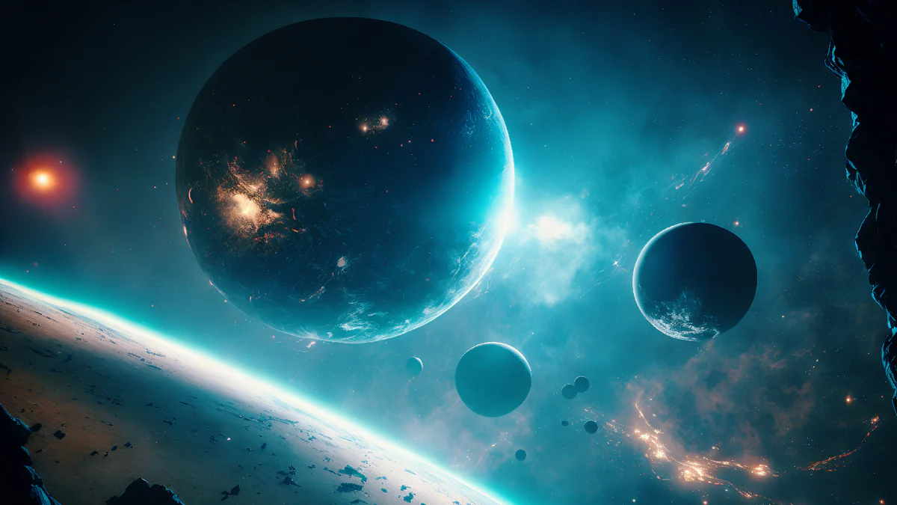
Exploring exoplanets

Slide 2
Introduction
Overview:
Our project will provide an accessible learning platform for exoplanet education that combines scientific visualizations, and machine learning models
Allowing students to explore exoplanets/planetary system using real - world data and understand how scientists use data to find these distant worlds

Slide 3
Plan
Find exoplanets:
Use well trained ML model to find exoplanets
Use data from Tess space mission or kepler
Visualize exoplanets:
From the model predictions, create visual representation of these celestial bodies

